Slide 1
Visualising employee attendance Trends with Excel charts

Slide 2
Planning and Designing the Excel Attendance Tracker
1️⃣ Set attendance requirements. This is more like a documented policy and set of rules to guide an organization on matters relating to attendance.
2️⃣ Ensure that your Excel employee attendance tracker carries the requirements pointing out specific actions required from employees, including details of arrival to work and the number of working hours. 3️⃣ Incorporate guidelines for when employees can take leaves and what the process entails. That includes specifics like the length of breaks given each day, payroll calculations, and disciplinary measures for affected employees can be featured in the employee hours tracker. 4️⃣ With the attendance requirements for your Excel employee tracker determined, implement a tracker structure and layout. Thankfully, Excel has a structure of different spreadsheets. Apart from linking them, each sheet

Slide 3
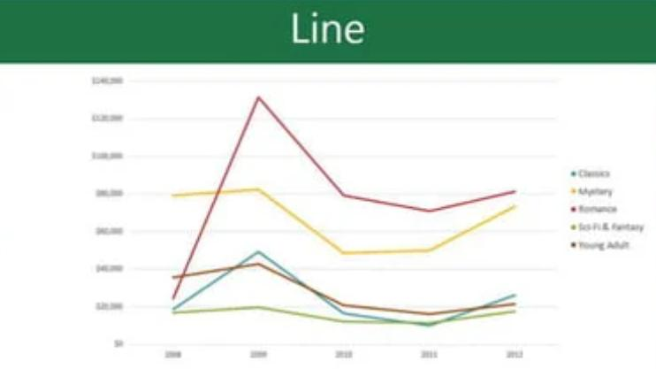
LINE CHARTS
• Line charts are ideal for showing trends. The data points are connected with lines, making it easy to see whether values are increasing or decreasing over time. with lines, making it easy to see whether values are increasing or decreasing over time.

Slide 4
4️⃣ With the attendance requirements for your Excel employee tracker determined, implement a tracker structure and layout. Thankfully, Excel has a structure of different spreadsheets. Apart from linking them, each sheet is structured with columns and rows.
5️⃣ Depending on the fields you want to be filled, you can request certain information. For example, your attendance tracker form or sheet can contain a name, activity, month, days, time in, time out, breaks, and more. These fields and other information must be filled by your employers using accurate data that helps you track their absenteeism and punctuality.

Slide 5
Setting Up the Excel Attendance Tracker
Start a new Excel spreadsheet and create columns for each date of the particular month. Create another column for employees to input their names in the left corner. Fill the columns matching weekends and public holidays with some color. Apply data validation. You’ll find that in the drop-down in the Data tab of the taskbar. Data Validation prevents inconsistency in inputs from employees. Use the Home tab to lock the cells beside the

Slide 6
Key components
Point allocation: Points are assigned based on specific attendance behaviors, providing a quantitative measure of attendance reliability. Thresholds and rules: Defined thresholds determine the consequences associated with accumulating points over a given period. This can include disciplinary actions or rewards based on attendance performance. Tracking and monitoring: Excel spreadsheets are used to record and calculate points accrued by employees, providing a transparent and accessible way to track attendance trends over time.

Slide 7
Applying conditional formatting for data visualization
Applying conditional formatting is important, as it helps visually explore and analyze data, spot problems, and identify trends and patterns. Further, conditional formatting makes it very easy to highlight interesting cells or ranges of cells. You can then visualize data with the components below.

Slide 8
Adding Automated Functions and Features
Automating attendance sheet template Excel and other processes is easy to learn, and leaves a significant impact on your team’s productivity level. You can automate a vast range of functions and features without asking your team to constantly check on them. Excel automation examples include refresh data, new file creation, external data source connections, etc.

Slide 9
Implementing data validation for error prevention
Data validation is another feature you can add. It allows you to restrict the type, range, or format of the data that can be entered in a cell or a range of cells. This way, you can prevent a lot of errors. For example, data validation can be used to ensure that only specific values like numbers or dates are entered. It also ensures that the values meet specific criteria, such as matching a list of predefined options or between minimum and maximum values.

Slide 10
Including formulas for automatic calculations
The automatic calculation is a program to consider. It can calculate new formula results automatically when a value or formula component changes. For example, if you have an Excel sheet attendance with the formula =A1+A2, Excel can automatically review the values in cells A1 and A2. It can then add them together to populate the sum in the cell containing the formula. If the value in A1 is changed, this Excel program can auto-calculate to generate the sum of the new value. The auto calculation program is important, as it can be used to create a formula for which you expect to change relevant data points. Even if you make changes to the attendance Excel spreadsheet, the formula still shifts to reflect that change. It comes in handy when you’re working with large amounts of data you have to update.

Slide 11
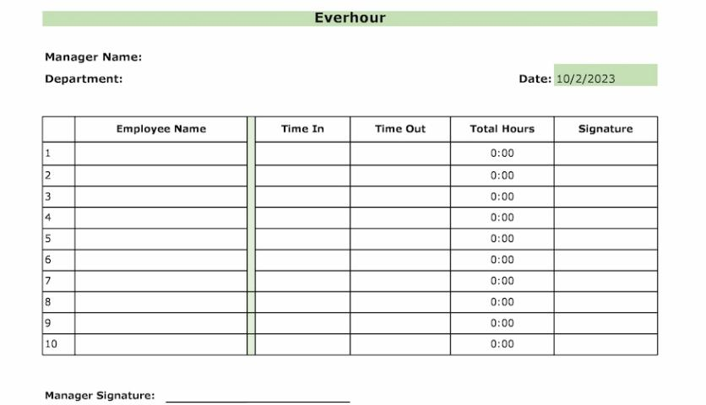
Excel Attendance Tracker Template
Depending on what your organization needs, choose the ideal Excel attendance tracker template for some operations.
Below are the most common Excel attendance
tracker templates: Daily attendance Excel tracker template

Slide 12
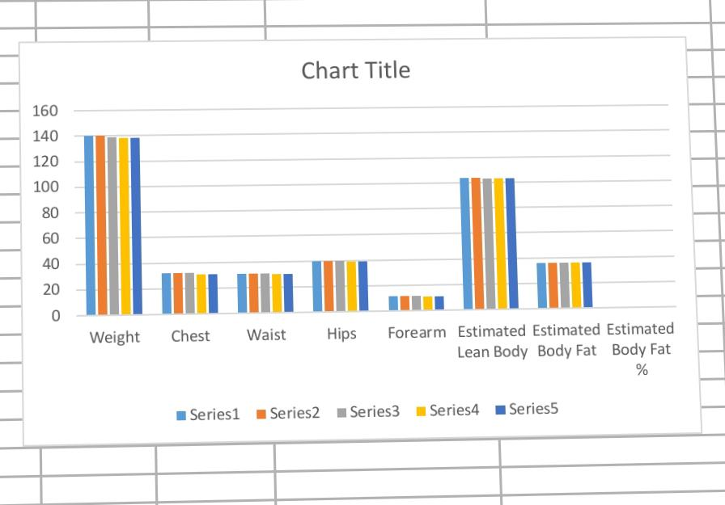
RESULTS

Slide 13
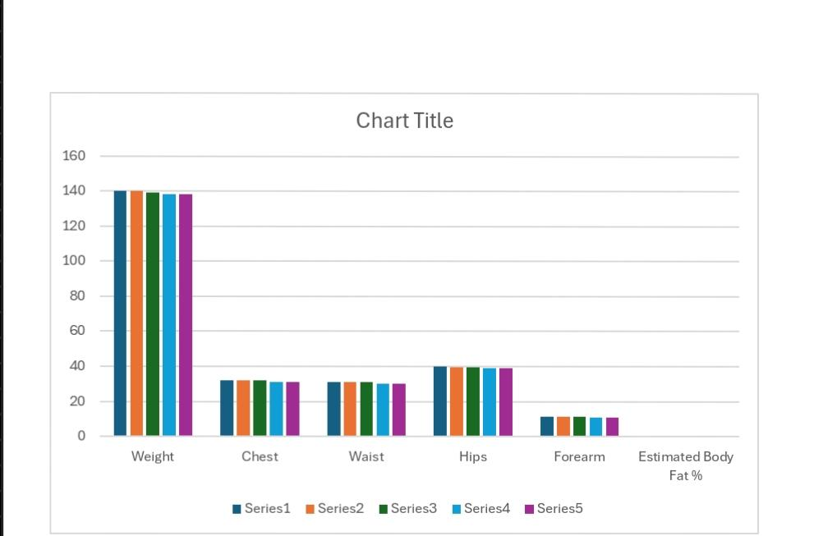
Result

Slide 14
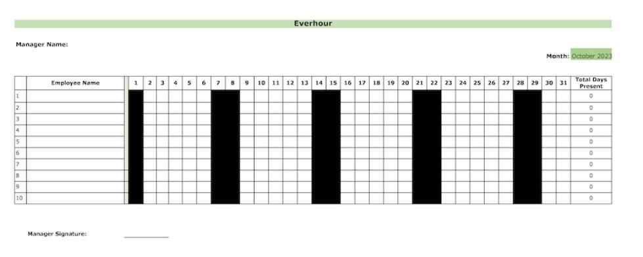
Monthly attendance Excel tracker template
This template will allow
you to track attendance
on a monthly basis which
is extremely crucial for
the payroll and budgeting.

Slide 15
THANK YOU...

